Slide 1
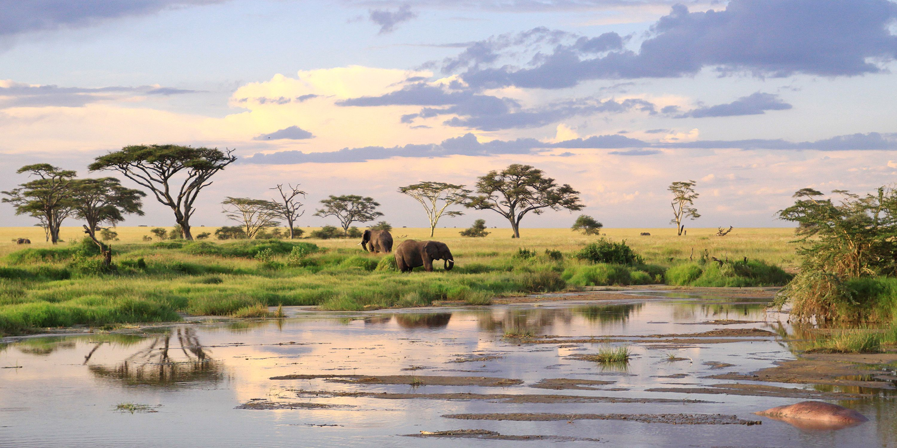
UWA Final Project
Study of different rainfall station data in predicting flood events in the Serengeti

Slide 2
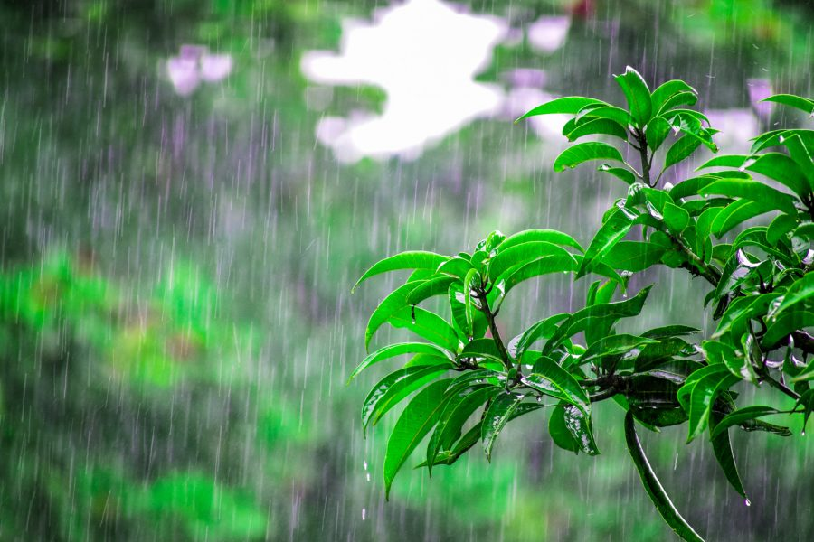
About
An analysis of environmental data using machine learning models as a predictor for flooding events in the Serengeti to answer the following questions.
We were able to source historic rainfall data from 4 weather stations and a downstream river level monitoring station.

Slide 3
Questions
What are the most effective methods of choosing a location for a rainfall station?
How many rainfall stations do we need to have an accurate prediction?
What is the accuracy across different Machine Learning models?
Is it possible to use Machine Learning to predict the risk of downstream flooding events from real time rainfall data?

Slide 4
Data Preparation
Hypothetical data to give us an idea of rainfall in wet and dry seasons
Data was imported and cleaned using Pandas
Data is then exported to SQLite where it can be called with flask APIs for display in our HTML
To visualise our data, primarily used Tableau and Leaflet & JQuery.

Slide 5
Machine Learning Models
Logistics Regression
No change in model accuracy between base, RFECV (Select Features) and a Tuned Model using GSCV.
Random Forest
Best model accuracy with base model, but RFECV and GSCV comparable.

Slide 6
Deployment to Heroku
https://rainfall-in-serengeti.herokuapp.com/

Slide 7
Conclusions
Worthwhile to use testing data on a smaller proportion of low risk data
Insufficient data because only one wet and one dry season was assumed.
Is having more than one weather station essential?
Contingency? Risk mitigation? Maintenance?

Slide 8
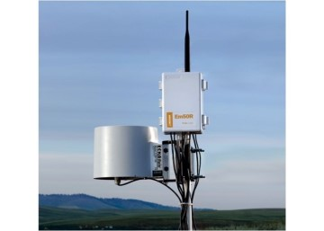
Future Considerations
With more time
Data from multiple seasons can be used to train our ML models.
Elevation, ground and ambient temperature, barometric fluctuations can be used as variables to train our ML models for more accurate predictions.
Test for other water systems. Does the model work elsewhere?
Alternatively, can other catchments provide even more variability in conditions which will result in a more accurate model? Or provide additional insight to geographic factors which may affect water level readings?

